Slide 1
2018 BMES Science Fair

Slide 2
Brief
Who: Bells Mill Elementary School
What: 2018 Science Fair
When: Friday, April 13th
Set up: 8-9:00am (All Purpose Room)
Session I: Daytime viewing: 9:30 – 11:15am
Session II: Community viewing: 7-8:30pm
Where: All Purpose Room
Why: Interdisciplinary experience fostering creativity, developing confidence, and fostering a spirit of scientific inquiry
How: “It takes a village” …. Teachers, Parents, Children, Volunteers
Science
Club Bells Mill: Up Up and Away! Featuring Mad Science of Washington
PTA: Traveling Planetarium (K-3)

Slide 3
Registration
PTA Sponsored event supported by parents, teachers, students and BMES community.
Thank you to Lang Lin
Sign-up genius:
Student Participation (Name, Teacher, Science Project ID)
Volunteers

Slide 4
Science Fair Participation
Choose a topic that will allow you to do an experiment to answer a question.
Guide your young scientists
Equipment
Poster Board or Presentation
Bring presentation to school
Participate in presenting

Slide 5
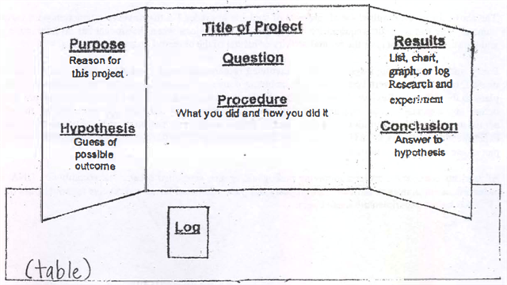
Science Project Display
Display should clearly show what the experiment was about and that the scientific method was followed during the experiment.
Guideline of information
Question may be the title
Photographs, graphs, chars and drawings should be used to show procedure, observations, and results of the experiment.
Write name, grade, and teacher’s name on the BACK of your science project display.

Slide 6
How to Prepare a Science Fair Project
Select a Topic: choose something your interested in and something you want to learn more about. Talk to teachers, parents, or librarians for ideas. A hobby might lead to a good topic. Choose a topic that will allow you to do an experiment to answer a question.
Purpose: tells why you are doing the science project and what you hope to learn.
Hypothesis: make a guess about what you think is going to happen when you perform experiment.
Research: After topic has been selected, start research process. Read books and articles about the selected subject.
Experiment: Plan and organize an experiment. Collect needed material. Perform experiment under controlled conditions. Keep careful records in a special notebook.
Procedure: Write the step-by-step procedure you plan to follow to perform experiment. Write daily procedure, date, observations, and results in a log or journal.
Data – record data
Results – summarize using charts and graphs
Conclusion: Write conclusion and compare what happened to your hypothesis.
Exhibit: This is the visual presentation of your project, so prepare carefully using graphs, charts and clear bold lettering to highlight display. Take pictures or make drawings of experiment.

Slide 7
Science Research Poster
Science Poster – youngest children who are curious about a science topic. Child will research topic and create an informative poster on the topic.
Use at least 2 sources of information
Prepare a poster attractively presenting the information
Models and collected must be neatly presented
Be knowledgeable of the research and able to present

Slide 8
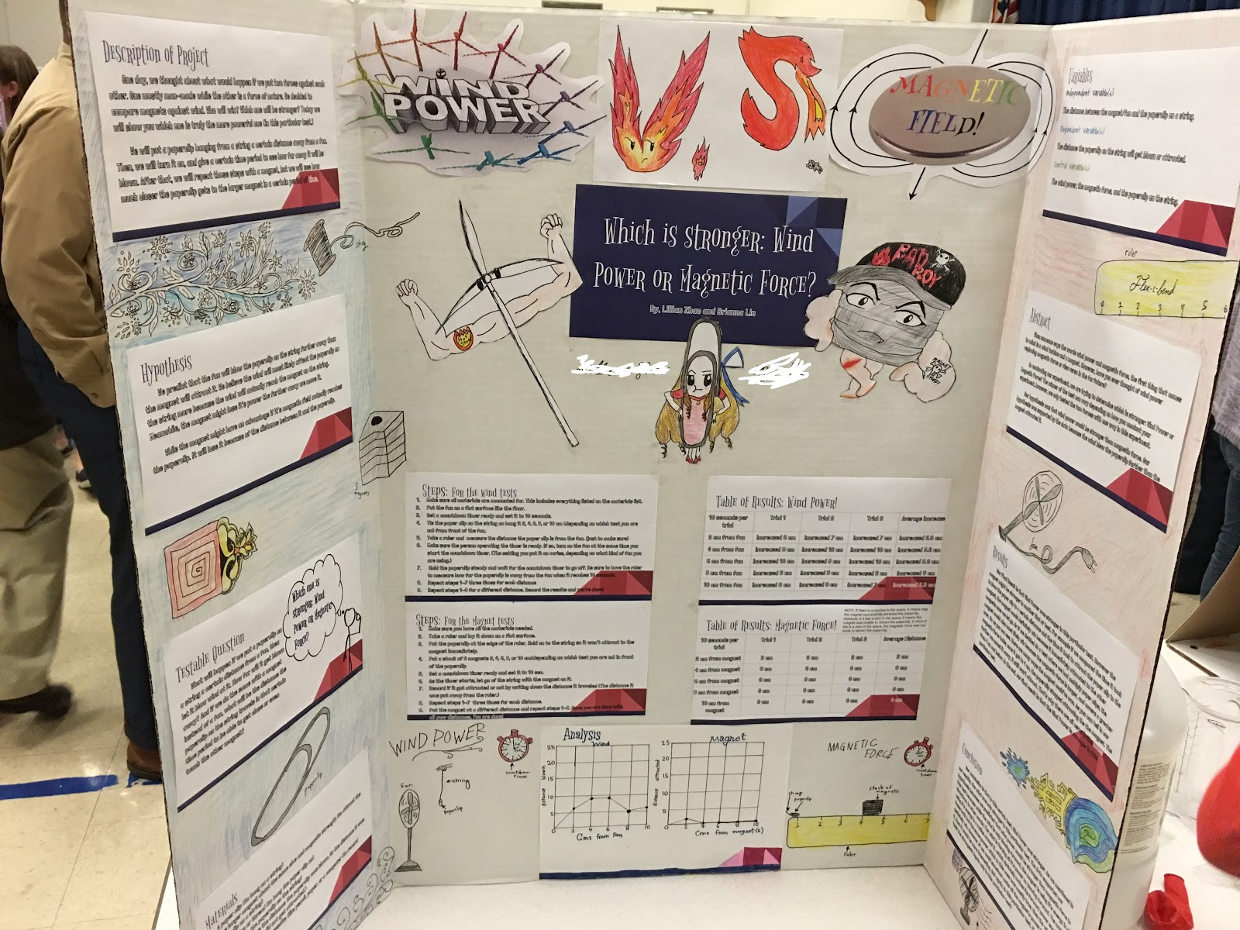
Sample Poster

Slide 9
About Science Projects
Projects must be safe. All material/setup must be durable and safe.
Project must not hurt anyone or not hurt animals.
Dangerous chemicals are not allowed.
No open ﬂames are allowed.
Each project (poster/demo setup) is limited to a tabletop area approximately 36 x 48”, and should be able to stand by itself. We recommend using a tri‐fold display board.
On the top right corner of the poster board, please use marker to write the grade of the young scientists.
Students can team up in a project

Slide 10
What will young scientists receive?
A memorable hands on experience
Ribbon
Certificate with their name

Slide 11
Any questions?
Contact information:
Ms. Jennifer Dugan jdugan.jdugan@gmail.com
Ms. Jia Li jiali.lgw@gmail.com
Thank you for your participation!

